Slide 1
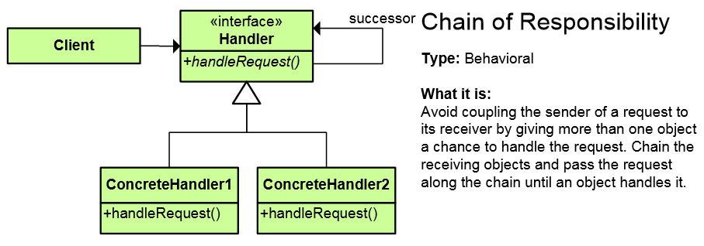
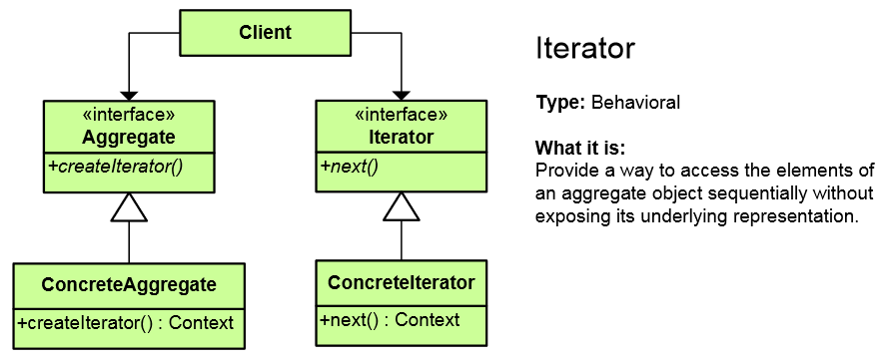
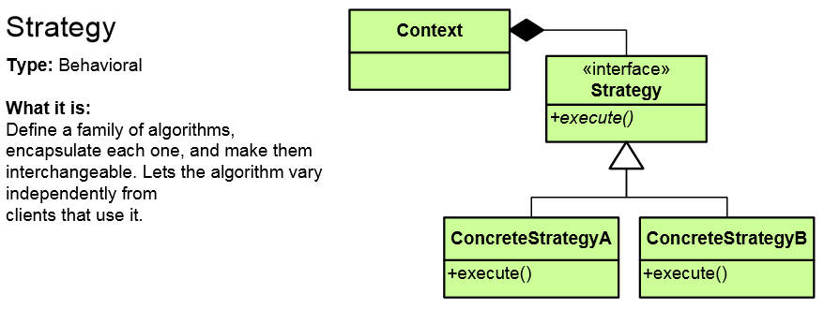
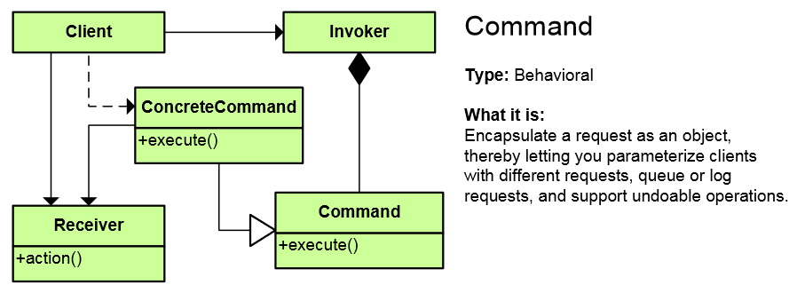
Behavioral Patterns
Concerned with communication (interaction) between the objects
High-Quality Code
Telerik Software Academy
http://academy.telerik.com

Slide 2
Behavioral Patterns
Concerned with communication (interaction) between the objects
Either with the assignment of responsibilities between objects
Or encapsulating behavior in an object and delegating requests to it
Increase flexibility in carrying out cross-classes communication

Slide 3
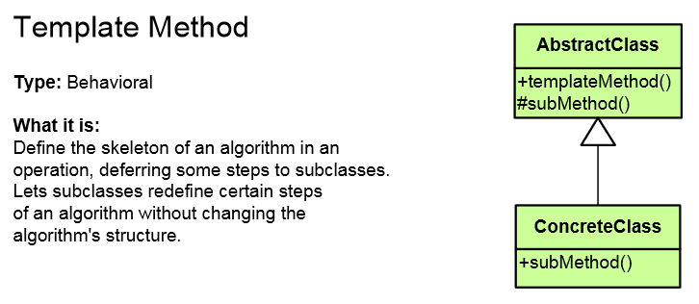
List of Behavioral Patterns
Chain of Responsibility
Iterator
Template Method
Strategy
Command
Observer
Mediator
Memento
Visitor
State
Interpreter
Specification

Slide 4
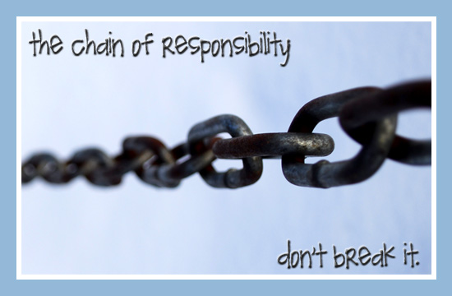
Chain of Responsibility

Slide 5
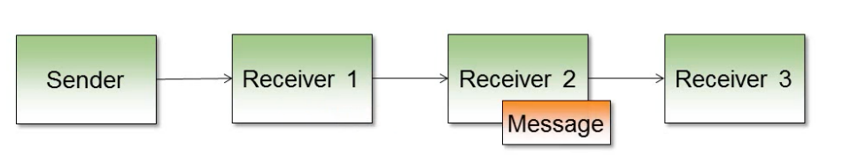
Chain of Responsibility Pattern
Allows you to pass a request to from an object to the next until the request is fulfilled
Ordered list of handlers
Analogous to the exception handling
Simplifies object interconnections
Each sender keeps a single reference to the next
There is also Tree of Responsibility

Slide 6

Chain of Responsibility Pattern
Sender is aware of only one receiver
Each receiver is only aware of the next receiver
Receivers process or send to the next
The sender does not know who received the message
The first receiver to handle the message terminates the chain
The order of the list matters

Slide 7
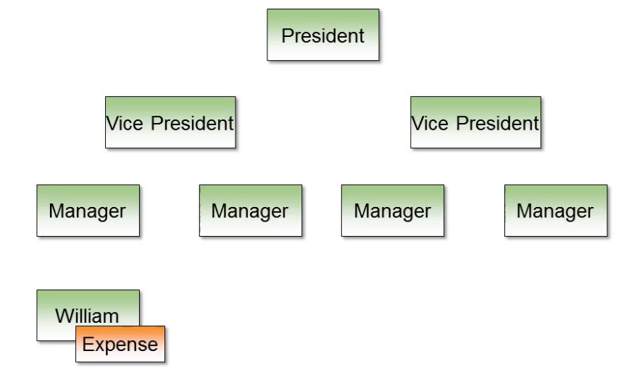
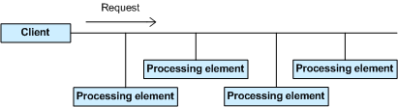
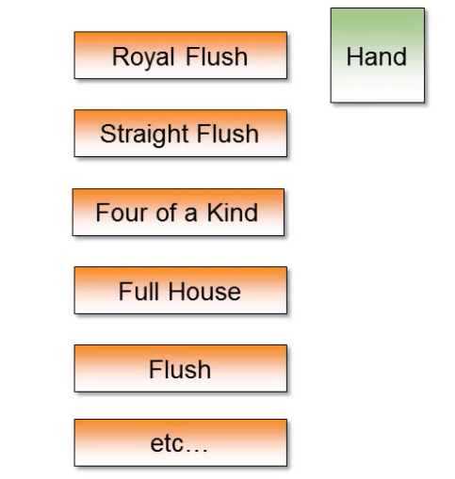
Chain of Responsibility Pattern
Examples and class diagrams

Slide 8
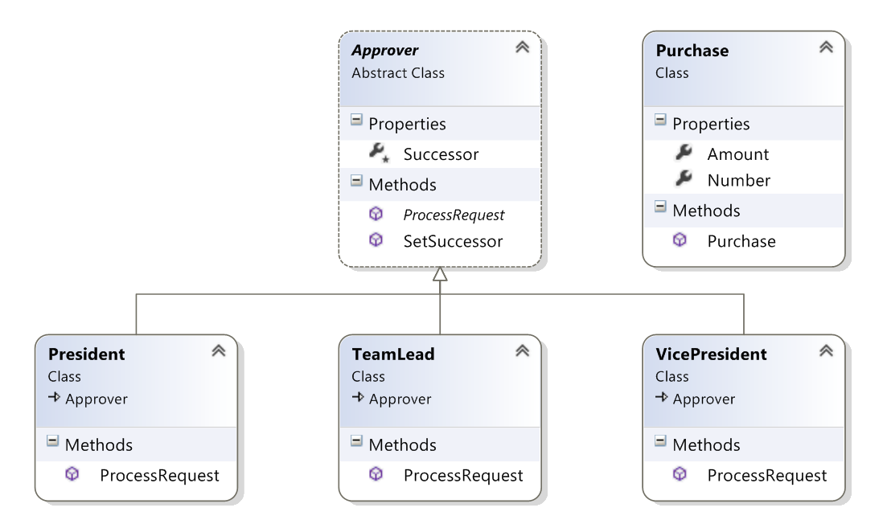
Chain of Responsibility Pattern
Examples and class diagram

Slide 9

Iterator

Slide 10
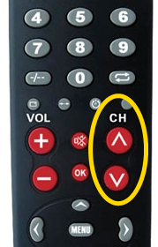
Iterator Pattern
Access to the elements of a complex object without revealing its actual presentation
Various ways of data structure traversing
Hides traversing details
By separating the iteration logic, the aggregator no longer needs to keep track of the traversal state
Interchangeable traversing algorithms
Unified abstract interface for iterating over various data structures
foreach loops in C# uses the Iterator pattern (yield generates enumerators)

Slide 11
Iterator Pattern (2)
Each collection type requires 2 implementations
Aggregate interface is in the collection itself
Client retrieves an Iterator from the Aggregate

Slide 12
Iterator in .NET – Example
public interface IEnumerator { // Iterator
bool MoveNext();
object Current { get; }
void Reset();
}
public interface IEnumerable { // Aggregate interface
IEnumerator GetEnumerator();
}
private class ConcreteEnumerator : IEnumerator {
// Implement IEnumerator interface
}
var enumerator = someObject.GetEnumerator();
while (enumerator.MoveNext()) {
// work with enumerator.Current
}
foreach

Slide 13
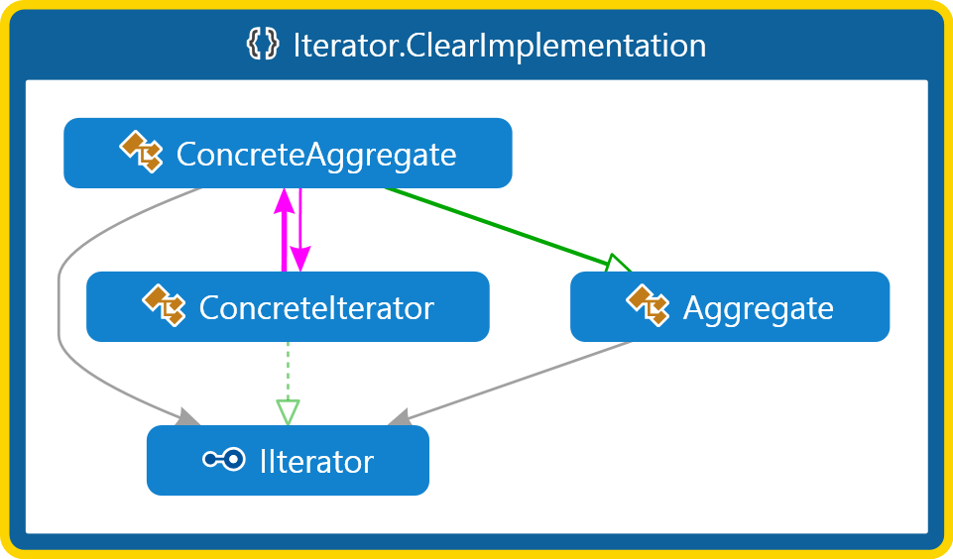
Iterator – Demo

Slide 14

Template Method

Slide 15

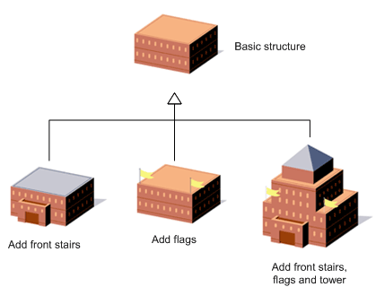
Template Method
Defines the base of an algorithm in a method, leaving some implementation to its subclasses
Template Method allows the subclasses to redefine the implementation of some of the parts of the algorithm
Doesn’t let the subclasses to change the algorithm structure
Relies on inheritance
Strategy on composition
Usually override of virtual or abstract method (hook)
life cycle

Slide 16
Template Method (2)
When to use:
Two or more classes should follow the same common algorithm or workflow
The workflow never changes
Subclasses may redefine the steps (not order)
Some steps may be implemented in the base class (DRY)
In WebForms we can override the Render() method to output the HTML or intercept into the page life cycle

Slide 17
Template Method – Example
public abstract class HotDrink {
public void PrepareRecipe()
{
BoilWater(); Brew(); PourInCup(); AddSpices();
}
protected abstract void Brew();
protected abstract void AddSpices();
private void BoilWater() { ... }
private void PourInCup() { ... }
}
public class Coffee : HotDrink {
protected override void Brew() { ... }
protected override void AddSpices() { ... }
}
public class Tea : HotDrink {
protected override void Brew() { ... }
protected override void AddSpices() { ... }
}
Implemented by subclasses

Slide 18
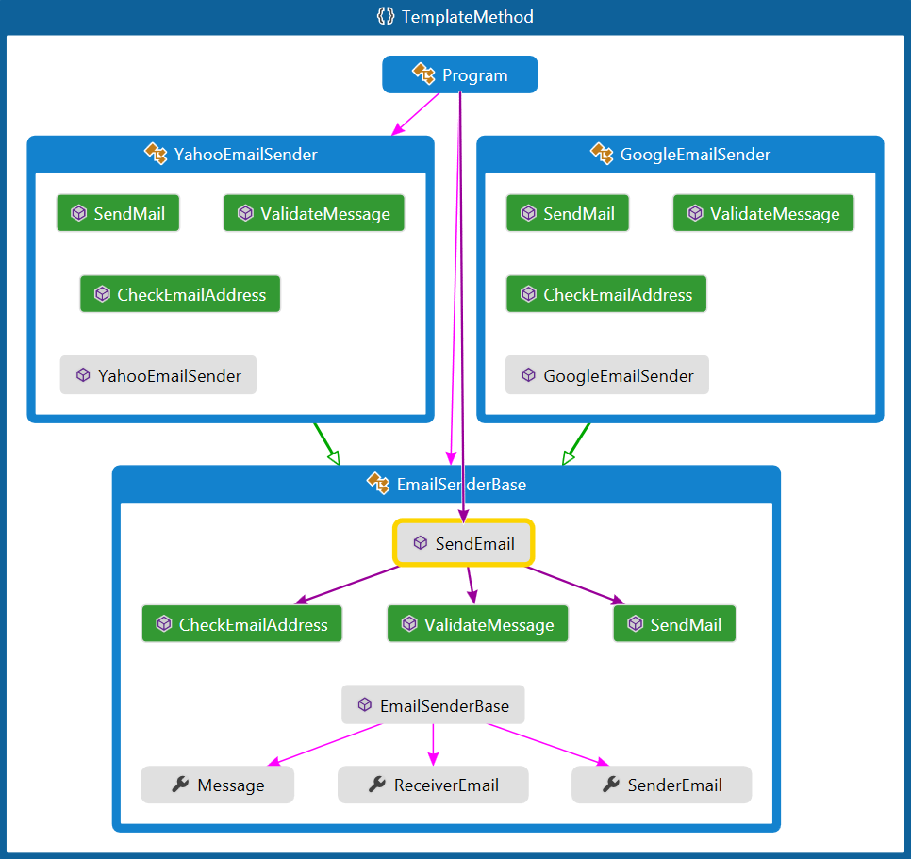
Template Method – Demo

Slide 19

Strategy

Slide 20
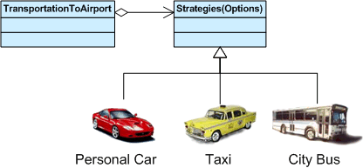
Strategy Pattern
Main purpose
Encapsulate a family of related algorithms
Let the algorithm vary and evolve separate from the class using it
Allow a class to maintain a single purpose
Separate the calculation from the delivery of its results
When to consider
Switch/if statements
Adding a new operation will cause class modification

Slide 21
Strategy Pattern
Encapsulates an algorithm inside a class
Making each algorithm replaceable by others
All the algorithms can work with the same data transparently
The client can transparently work with each algorithm

Slide 22

Strategy Pattern
Consequences
Strategies may not use members of the containing class
Tests are easier to be written for individual concrete strategies
Strategies may be mocked when testing the context class
Adding new strategies does not modify anything
Various variations
In .NET using Func or Delegates
Property injection
Pass strategy on a method or to the constructor

Slide 23
Strategy Pattern – Example
abstract class SortStrategy {
public abstract void Sort(IList<object> list);
}
class QuickSort : SortStrategy {
public override void Sort(IList<object> list) { ... }
}
class MergeSort : SortStrategy {
public override void Sort(IList<object> list) { ... }
}
class SortedList {
private IList<object> list = new List<object>();
public void Sort(SortStrategy strategy) {
// sortStrategy can be passed in constructor
sortStrategy.Sort(list);
}
}

Slide 24
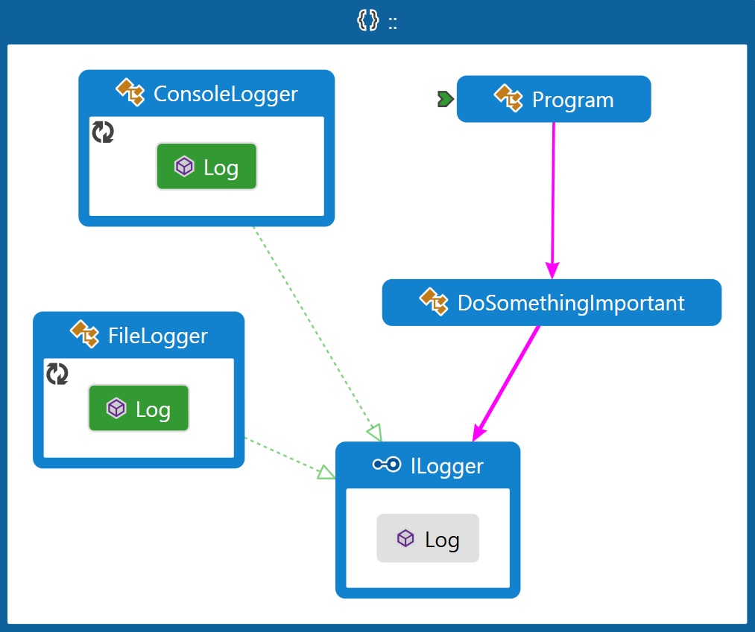
Strategy – Demo

Slide 25
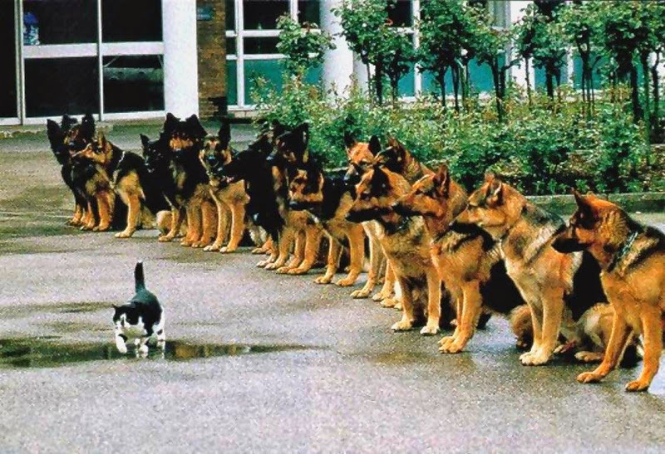
Command

Slide 26
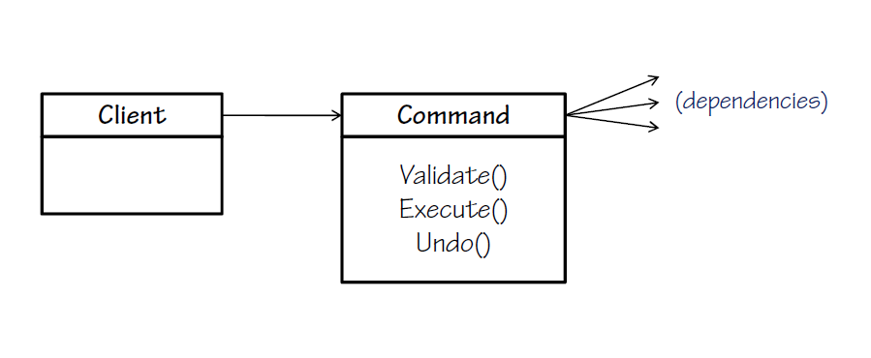
Command Pattern
An object that encapsulates all the information needed to call a method at a later time
Represents an action (request) as an object
Decouples clients that execute the command from the details and dependencies of the command logic
Can log requests
Can queue commands for later execution
Can validate requests
Support for undoable operations, etc.
A.k.a. Action or Transaction

Slide 27
Command Pattern (2)
Commands must be completely self-contained
Easy to add new commands (new class, OCP)
Command in WPF and Silverlight encapsulate a request to call a method with parameters

Slide 28
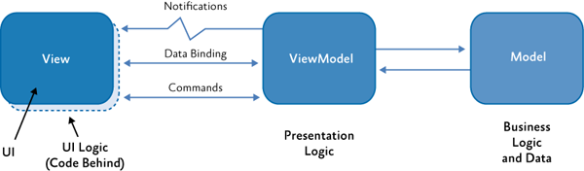
Command in WPF/Silverlight
ICommand interface
The view
bool CanExecute(object parameter);
void Execute(object parameter);
event EventHandler CanExecuteChanged;
<Button Grid.Row="1" Content="Toggle Can Click"
Command="{Binding ToggleExecuteCommand}"
Width="100" Height="100"/>

Slide 29
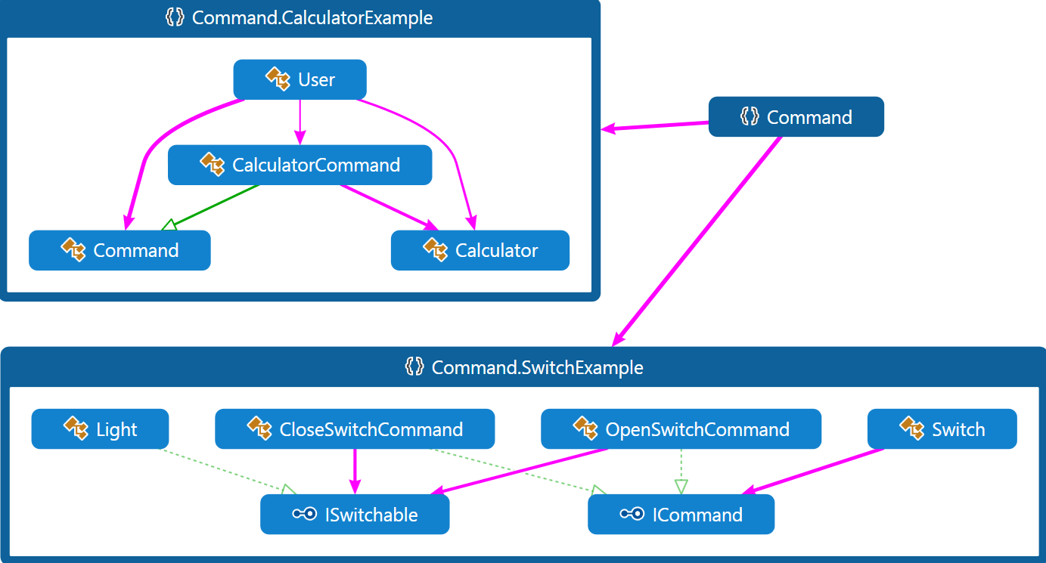
Command Pattern – Demos

Slide 30
Command – Related Patterns
Factory Pattern
Factories can be used to construct commands
Null Object
Returning “null command” can be useful instead of returning null
Composite
Can be useful to construct command with child commands
Execute() should call Execute() of all child commands

Slide 31

Observer

Slide 32

Observer Pattern
Define a one-to-many dependency between different objects
When one object changes state, all its dependents (observers) are notified and updated
Separates the subject and the observer
Presents interface, allowing objects to communicate without any concrete knowledge about each other
Also known as Publish-Subscribe
In C# events and event handlers use the Observer pattern
Used in GUI, data binding, network events, etc.

Slide 33
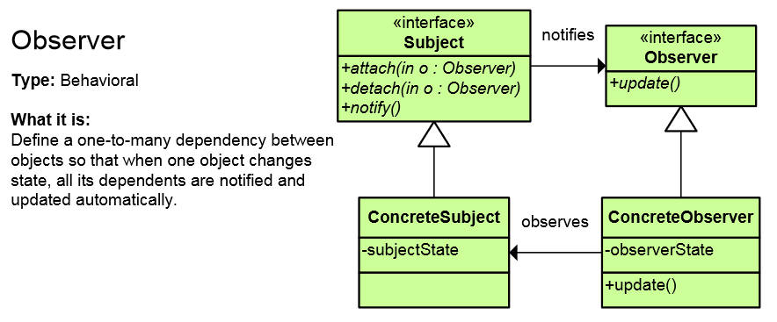
Observer Pattern (2)
Usages:
When one object is dependent on another
When changing one object requires changes in many others
When changes to an object should notify others without any knowledge of them

Slide 34
Observer Pattern (3)
Subject doesn’t know about concrete observers
The observers share common interface
Subject - register - unregister - notify
Observer
- update
Observer
- update
Observer
- update
Observer
- update
Observer
- update

Slide 35
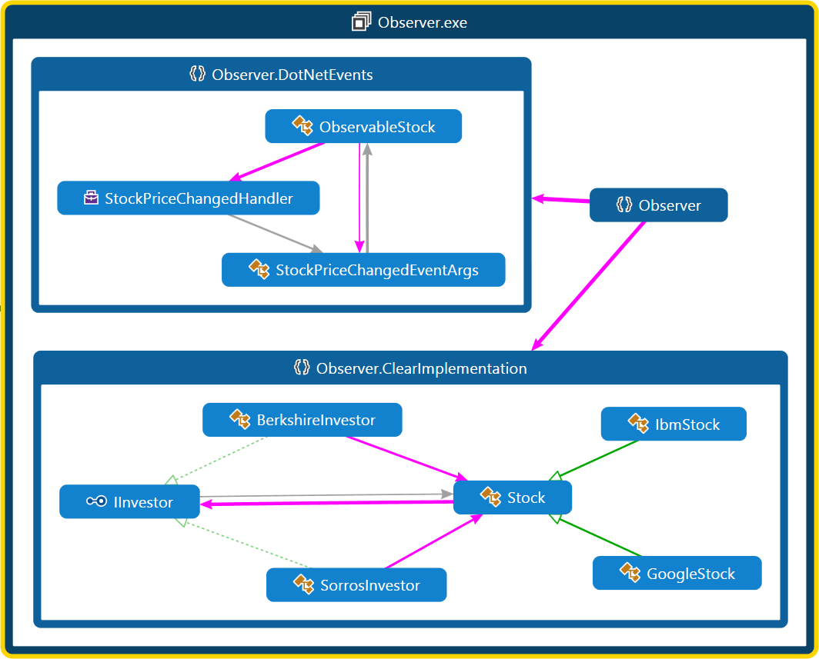
Observer Pattern – Demos

Slide 36
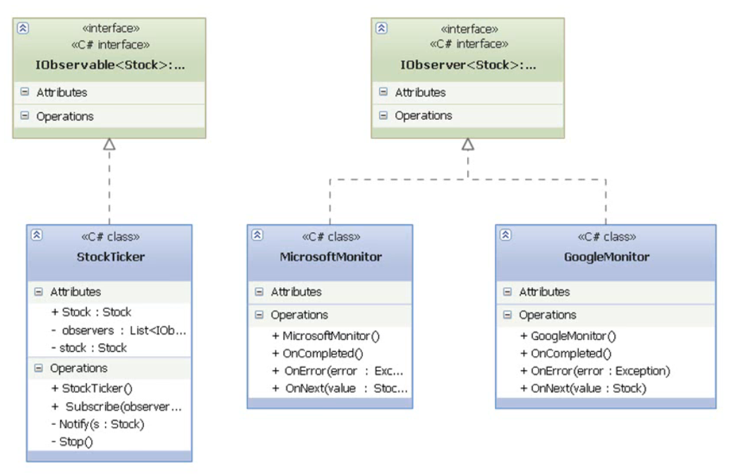
TODO: IObserver<T>

Slide 37

Mediator

Slide 38
Mediator Pattern
Simplifies communication between classes
Using one centralized component (the Mediator)
Define an object that encapsulates how a set of objects interact with each other
Without having these objects to have intimate knowledge about each others
Promotes loose coupling by keeping objects from referring to each other explicitly
Lets you vary their interaction independently
Example: The air traffic control center is the mediator for all the aircrafts; SignalR
Message queues are somewhat mediators

Slide 39
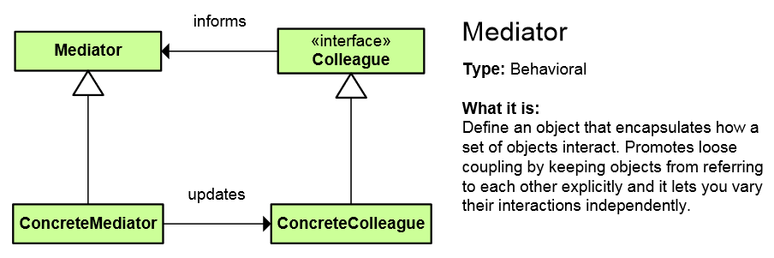
Mediator Pattern (2)
Colleagues – components that communicate with each other (sharing same base type)
Have knowledge of the Mediator component
Mediator(s) – the centralized component that manages communication between colleagues
Abstract so that different mediators can exists

Slide 40
Mediator – Advantages
Advantages
Hides all coordination between colleagues
Separation of concerns
Decouples colleagues
One-to-many relationship is preferred to many-to-many fashion
Disadvantages
The Mediator can become very large (fat) and very complicated as more logic is handled or as more type of colleagues are handled

Slide 41
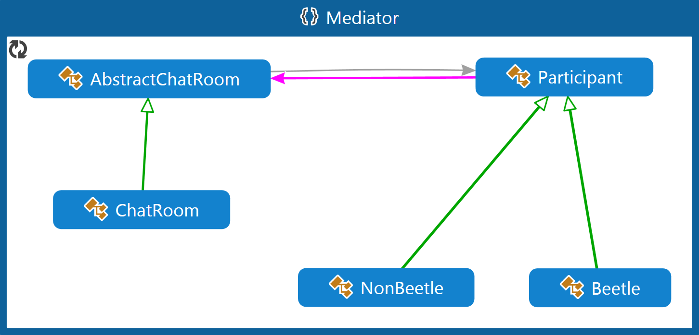
Mediator – Demo
Colleagues are the participants
The mediator is the chat room

Slide 42

Memento

Slide 43

Memento Pattern
Capture and restore an object's internal state
Promote undo or rollback to full object state
A magic cookie that encapsulates a “check point” capability
Serializing objects is somewhat saving their mementos (states) for future restore or transfer
Alternative implementation is to store only operations (or changes) instead of storing the state
Fewer memory (e.g. calculator)
May use Command for saving operations

Slide 44
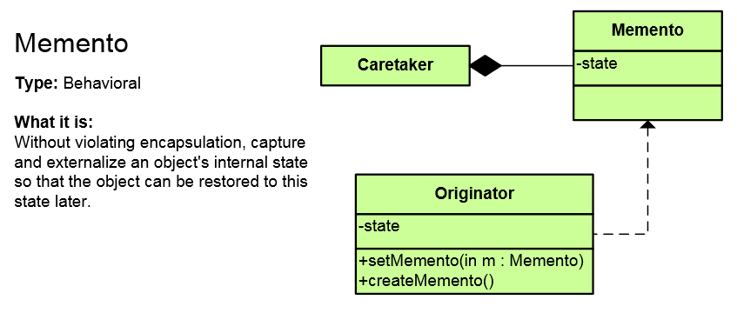
Memento Pattern (2)
Originator is the object whose state is being tracked as well is responsible for saving/restoring
The Caretaker performs operations on the Originator and is containing all states
The Memento is a value object that contains one state of the Originator (contains the data)

Slide 45
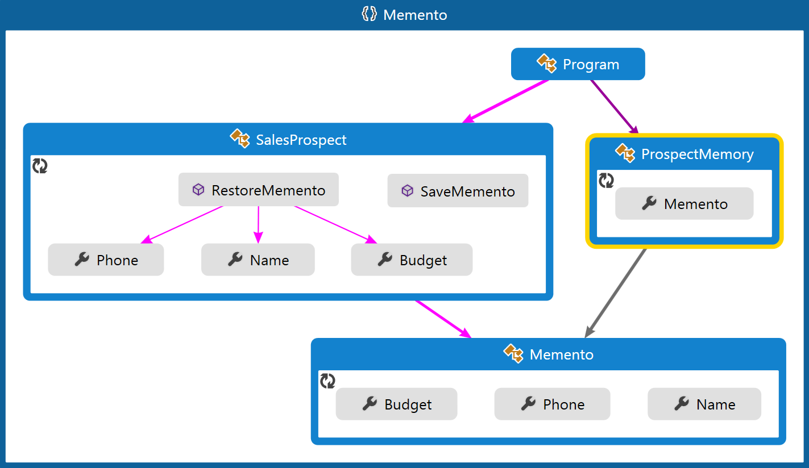
Memento – Demo
ProspectMemory is the Caretaker
SalesProspect is the Originator

Slide 46

Visitor

Slide 47
Visitor Pattern
Represent an operation to be performed on the elements of an object structure
Lets us define a new operation to a class without change the elements of the class
Double dispatch
Different operations on different objects
Allows adding functionality to class libraries for which cannot change the source
Hierarchical visitor
Visit every node in a hierarchical data structure
Roslyn example
EntityFramework

Slide 48
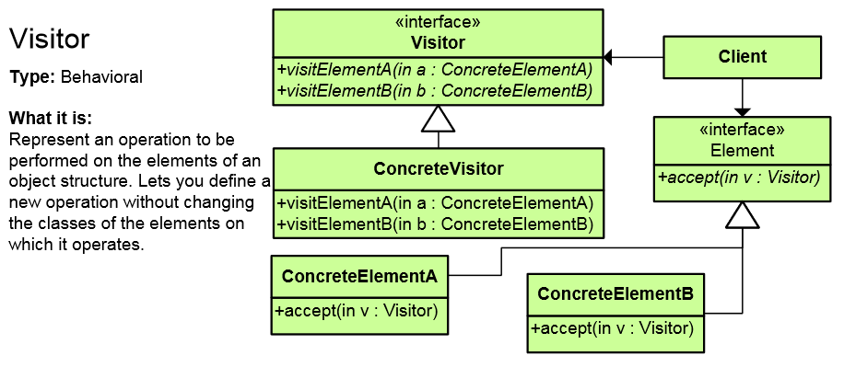
Visitor Pattern
Visitor declares a Visit operation for each class of ConcreteElement
Element defines an Accept operation that takes a visitor as an argument

Slide 49
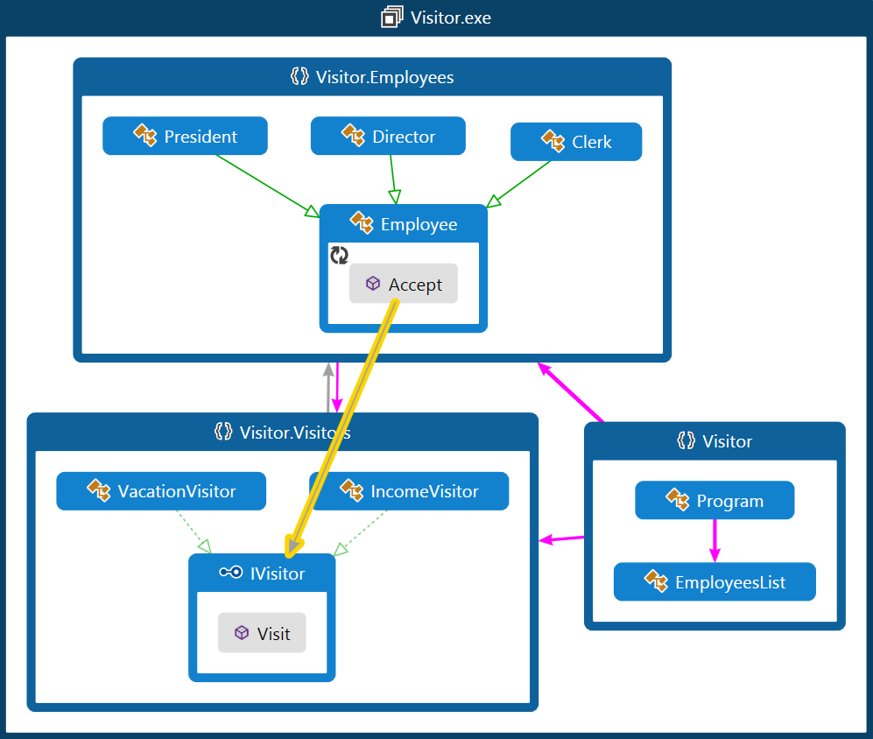
Visitor Pattern – Demo

Slide 50
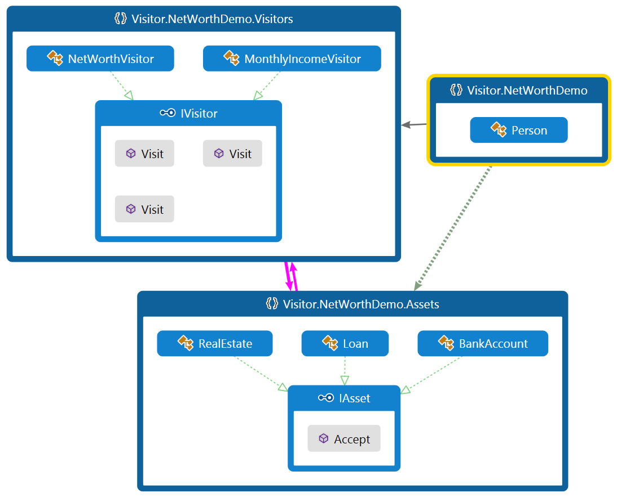
Visitor Pattern – Demo 2

Slide 51
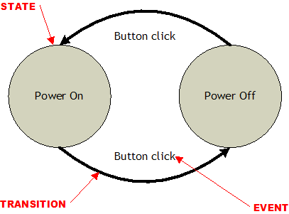
State

Slide 52
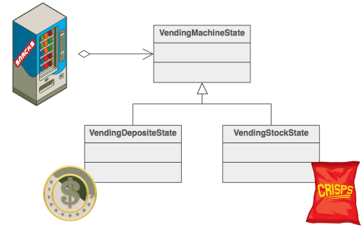
State Pattern
Alter an object's behavior when its state changes
Allows an object to have different behavior based on its internal state
Allows separation of concerns (easier testing)
Encapsulate the logic of each state (separate class)
Easy to add new states
An object-oriented state machine
Examples:
TCP connection states
Music Player (play, pause, stop, etc.)

Slide 53
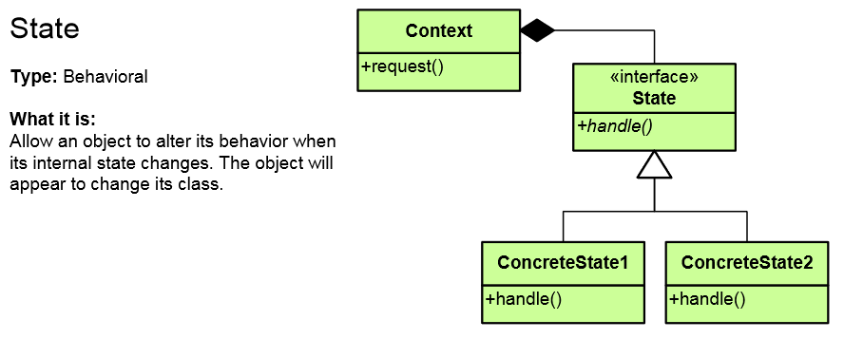
State Pattern (2)
States are hidden (internal), the client uses only the context
The context gets its behavior by delegating the operation to the current state
Context acts as a proxy to the states

Slide 54
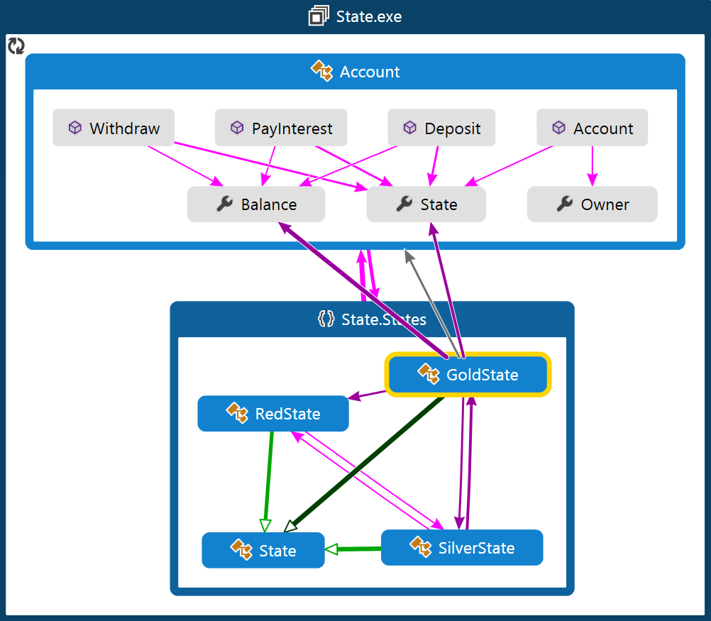
State Pattern – Demo

Slide 55

Interpreter

Slide 56
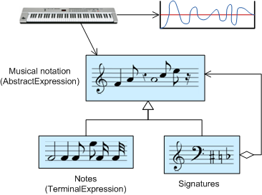
Interpreter Pattern
A way to include language (formal grammar) elements in a program
Define a representation for the grammar
Define an interpreter that uses the representation to interpret sentences (expressions)
Handling languages based on a set of rules
Limited area where it can be applied

Slide 57
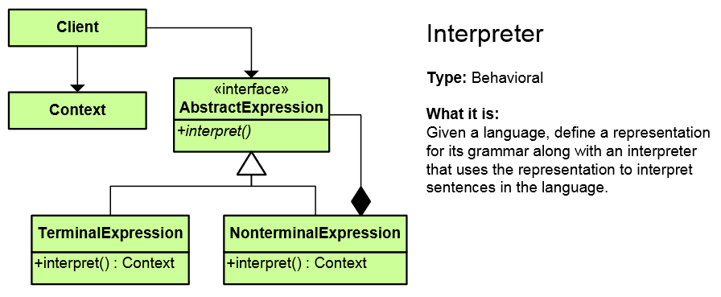
Interpreter Pattern (2)
Client builds (or is given) an abstract syntax tree representing a particular sentence
Context only contains information
NonterminalExpression represents combination of few expressions (Composite)

Slide 58
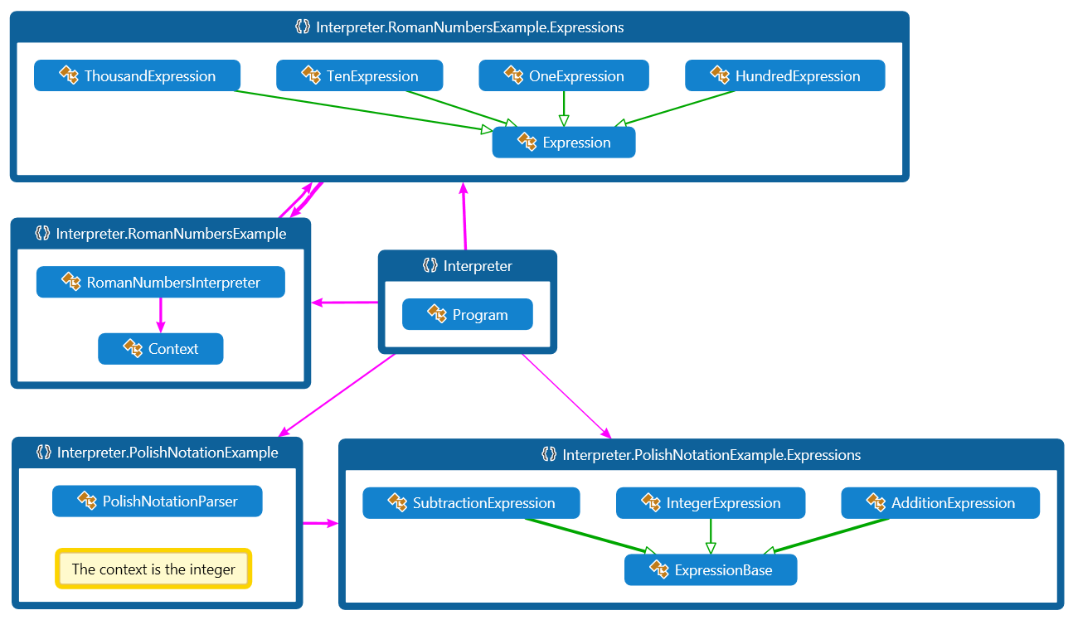
Interpreter Pattern – Demo

Slide 59

Specification (Rules) Pattern

Slide 60
Specification (Rules) Pattern
Combine different rules (and/or/not)
When we have complex and growing (frequently changing) business logic
Using Boolean logic
Separate individual rules from processing logic
New rules are added easily (OCP)
Examples
Gamification (badges/points)
Customer discount calculations / credit rating
Complex search
Read more: Evans, Eric (2004). Domain Driven Design. Addison-Wesley. p. 224

Slide 61
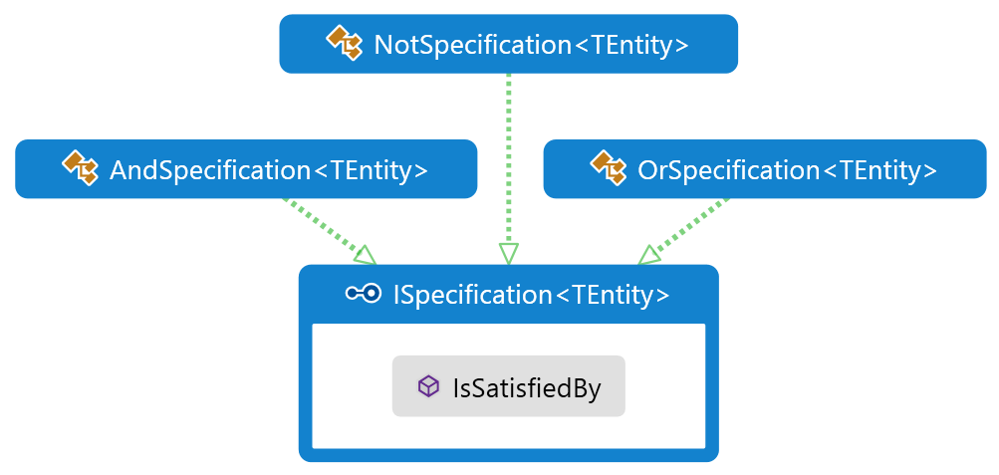
Specification (Rules) Pattern (2)
Few predefined rules are implemented (AND, OR, NOT) that implement ISpecification
Other custom specifications may also be added

Slide 62
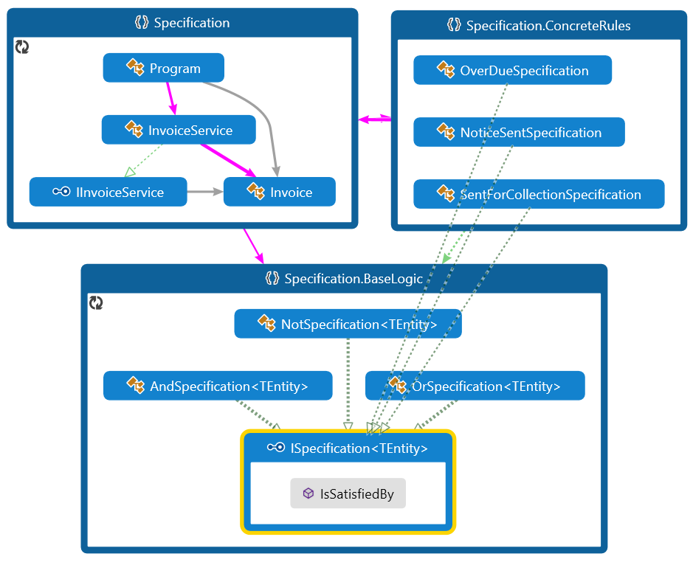
Specification Pattern – Demo

Slide 63

Other Behavioral Patterns

Slide 64
Other Behavioral Patterns
Null Object
Designed to act as a default value of an object
Rid program logic of null checks
Provide a non-functional object replacement
In .NET: String.Empty, EventArgs.Empty, etc.
Hierarchical visitor (Composite + Visitor)
Visit every node in a hierarchical data structure
Scheduled-task pattern (Delays execution)
Single-serving visitor (Use and then delete)
Protocol stack (Upper Layer / Lower Layer)

Slide 65
Behavioral Patterns
http://academy.telerik.com

Slide 66
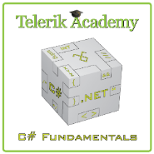



Free Trainings @ Telerik Academy
C# Programming @ Telerik Academy
csharpfundamentals.telerik.com
Telerik Software Academy
academy.telerik.com
Telerik Academy @ Facebook
facebook.com/TelerikAcademy
Telerik Software Academy Forums
forums.academy.telerik.com

